Slide 1
Delay in the Web Audio API
Part 2: Vibrato

Slide 2
The DelayNode
The DelayNode passes input audio to output after some specified delay time
Example: myNode = new DelayNode(context,{delayTime:0.005})
Delay is simple but its uses are very powerful
Comb filter
Feedback delay
Vibrato
Karplus-Strong algorithm

Slide 3
Vibrato
small, quasi-periodic variation in the pitch of a tone
popular performance technique
can be added to any audio signal as an audio effect.
characterised by
type of variation (the form of a periodic waveform),
LFO frequency (how often the pitch changes)
width (total amount of pitch variation).
works by changing the playback speed of sampled audio
Playing a sound faster raises its pitch, and playing it slower lowers the pitch
To add vibrato, playback speed needs to vary periodically, faster & slower than normal
we will add vibrato through the use of modulated delay lines.
Notes:
Vibrato is a popular performance technique, defined as a small, quasi-periodic variation in the pitch of a tone. Vibrato can also be added to any audio signal as an audio effect.
Vibrato is characterised by its type of variation (the form of a periodic waveform), its frequency (how often the pitch changes) and width (total amount of pitch variation).
The vibrato effect works by changing the playback speed of sampled audio. Playing a sound faster raises its pitch, and playing it slower lowers the pitch. To add a vibrato, then, the playback speed needs to be periodically varied to be faster and slower than normal. This can be achieved by controlling the playback rate on buffered audio sources, but we would like to be able to add vibrato to any audio stream. Hence we will add vibrato through the use of modulated delay lines.
A modulated delay line is a delay line whose delay length changes over time. Delay alone will not introduce a pitch shift. If a constant delay is applied, the sound will be delayed but otherwise identical to the original. But now suppose that the delay decreases each sample by a constant amount Then less samples need to be played out to complete one period of a periodic waveform. So the playback rate increases. That periodic waveform appears to be shorter, and hence higher in frequency. Similarly, if the length of the delay line increases each sample, then a periodic waveform appears to be longer, and its frequency will be lowered.
In fact, the pitch shift depends on the time derivative of delay length (Reiss & McPherson, 2014). For a frequency component with frequency fc, the new frequency after modulating the delay with a time varying delay $M\left(t\right)$, is:

Slide 4
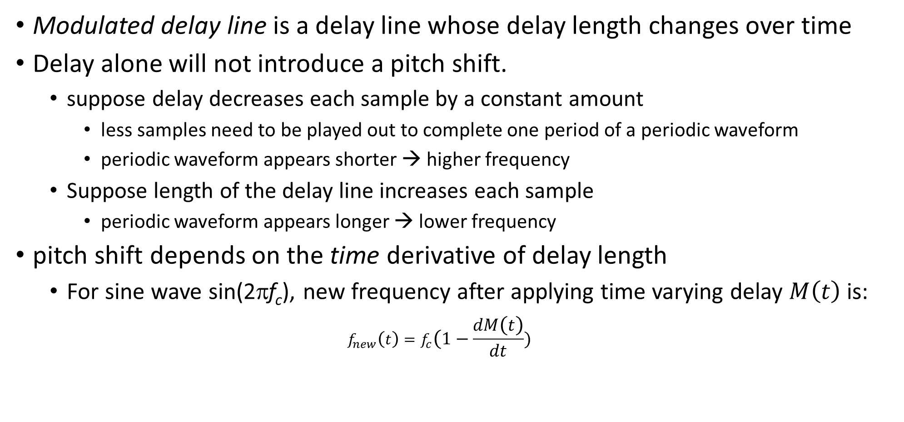
Vibrato implementation
Modulated delay line is a delay line whose delay length changes over time
Delay alone will not introduce a pitch shift.
suppose delay decreases each sample by a constant amount
less samples need to be played out to complete one period of a periodic waveform
periodic waveform appears shorter → higher frequency
Suppose length of the delay line increases each sample
periodic waveform appears longer → lower frequency
pitch shift depends on the time derivative of delay length
For sine wave sin(2πf_{c}), new frequency after applying time varying delay $M\left(t\right)$ is:
$$f_{new}\left(t\right)=f_{c}(1−\frac{dM\left(t\right)}{dt})$$
Notes:
A modulated delay line is a delay line whose delay length changes over time. Delay alone will not introduce a pitch shift. If a constant delay is applied, the sound will be delayed but otherwise identical to the original. But now suppose that the delay decreases each sample by a constant amount Then less samples need to be played out to complete one period of a periodic waveform. So the playback rate increases. That periodic waveform appears to be shorter, and hence higher in frequency. Similarly, if the length of the delay line increases each sample, then a periodic waveform appears to be longer, and its frequency will be lowered.
In fact, the pitch shift depends on the time derivative of delay length (Reiss & McPherson, 2014). For a frequency component with frequency fc, the new frequency after modulating the delay with a time varying delay $M\left(t\right)$, is:

Slide 5
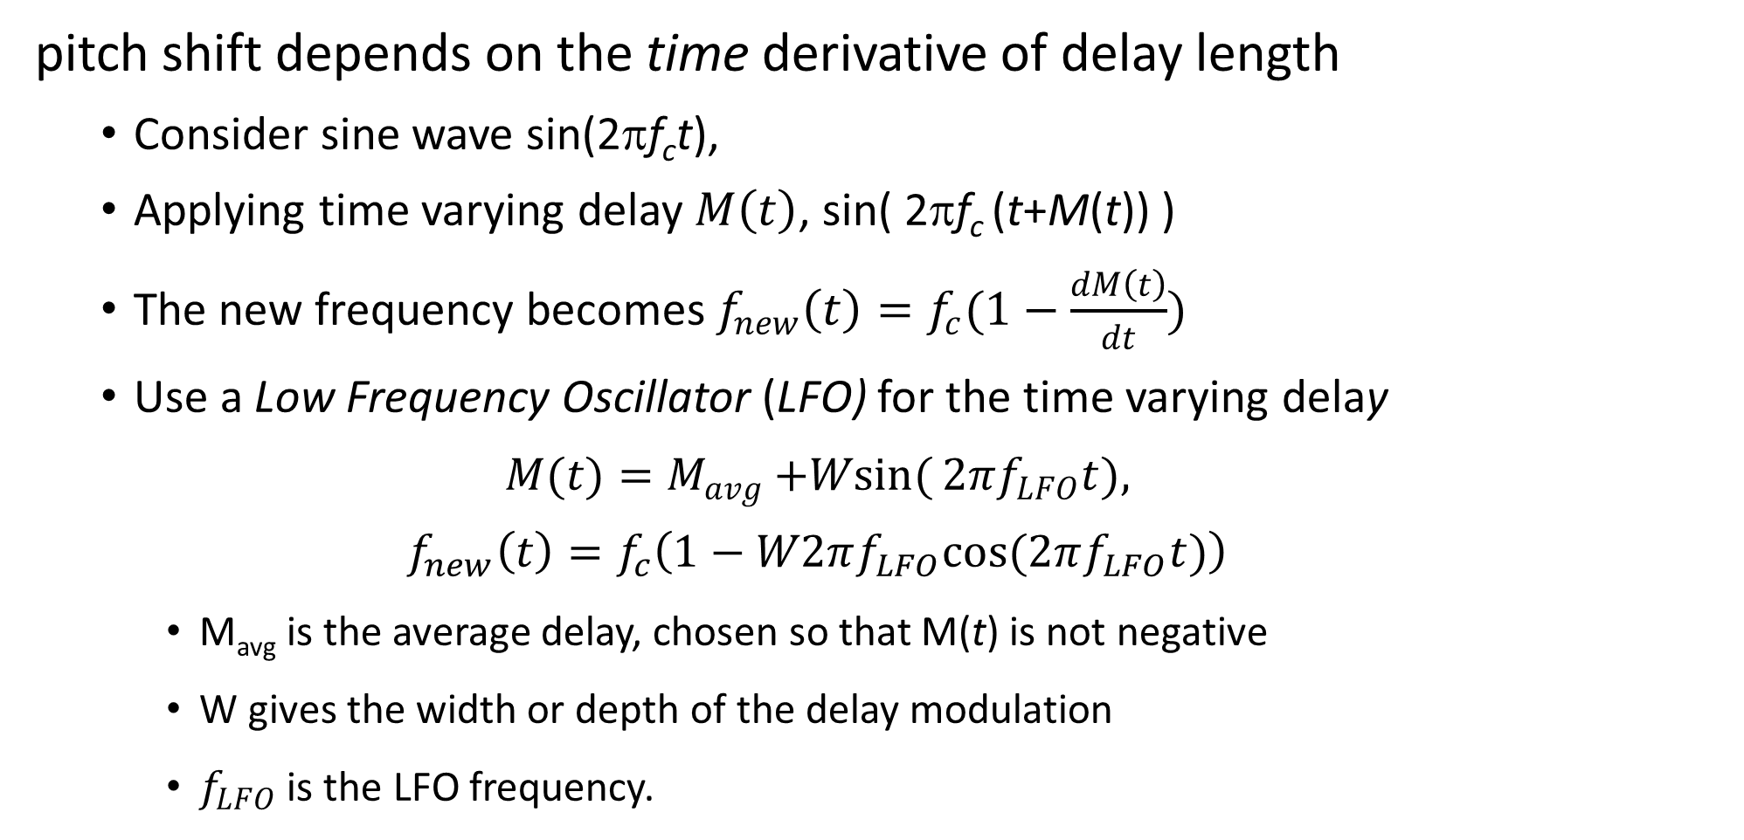
Vibrato – calculating pitch shift
pitch shift depends on the time derivative of delay length
Consider sine wave sin(2πf_{c}t),
Applying time varying delay $M\left(t\right)$, sin( 2πf_{c} (t+M(t)) )
The new frequency becomes$f_{new}\left(t\right)=f_{c}(1−\frac{dM\left(t\right)}{dt})$
Use a Low Frequency Oscillator (LFO) for the time varying delay
$$M(t)=M_{avg}{+Wsin(}2πf_{LFO}t),$$
$$f_{new}\left(t\right)=f_{c}\left(1−W2πf_{LFO}cos(2πf_{LFO}t)\right)$$
M_{avg} is the average delay, chosen so that M(t) is not negative
W gives the width or depth of the delay modulation
$f_{LFO}$ is the LFO frequency.
Notes:
A modulated delay line is a delay line whose delay length changes over time. Delay alone will not introduce a pitch shift. If a constant delay is applied, the sound will be delayed but otherwise identical to the original. But now suppose that the delay decreases each sample by a constant amount Then less samples need to be played out to complete one period of a periodic waveform. So the playback rate increases. That periodic waveform appears to be shorter, and hence higher in frequency. Similarly, if the length of the delay line increases each sample, then a periodic waveform appears to be longer, and its frequency will be lowered.
In fact, the pitch shift depends on the time derivative of delay length (Reiss & McPherson, 2014). For a frequency component with frequency fc, the new frequency after modulating the delay with a time varying delay $M\left(t\right)$, is:

Slide 6
Vibrato code
<audio id='file' controls loop onplay='context.resume()'>
<source src='trumpet.wav'>
</audio>
<br>Vibrato Depth
<input type='range' id='Depth' oninput='Update()' max=0.1 value=0 step='any'>
<br>Vibrato Frequency
<input type='range' id='LFO_F' oninput='Update()' max=8 value=5 step='any'>
<script src='vibrato.js'></script>
Connect the LFO to a gain node
Gain node gives the depth
Connect this gain node to the delayTime parameter
Modulates the delay
It will add to the intrinsic delayTime
Intrinsic delayTime gives the average delay
let context= new AudioContext()
let source = context.createMediaElementSource(file)
let delay= new DelayNode(context,{delayTime:1,maxDelayTime:10})
let LFOgain= new GainNode(context,{gain:0})
let LFO = new OscillatorNode(context,{frequency:5})
LFO.start()
source.connect(delay)
LFO.connect(LFOgain).connect(delay.delayTime)
delay.connect(context.destination)
function Update() {
console.log(LFO_F.value)
LFO.frequency.value = LFO_F.value
LFOgain.gain.value = Depth.value / (2*Math.PI*LFO_F.value)
}
LFO
Source
delay
destination

